Slide 1

"NYC's Housing Crisis: Navigating the Complex Rental Market in
1

Slide 2

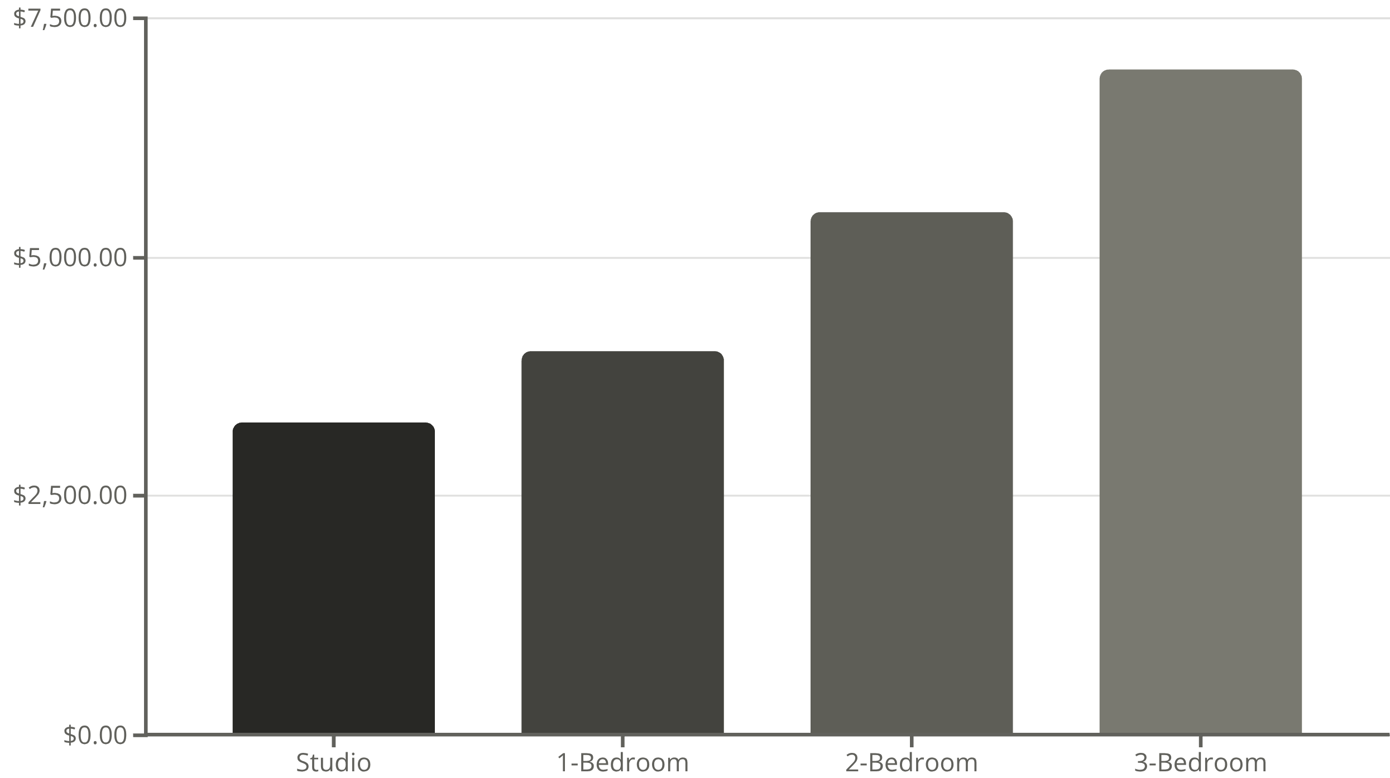
Average Monthly Rent by Apartment Size
100%
200%
Year-over-year increase
Above national average
Living in NYC means navigating a tough rental market with sky-high prices. Manhattan's average one-bedroom costs over $4,000 monthly

